Slide 1
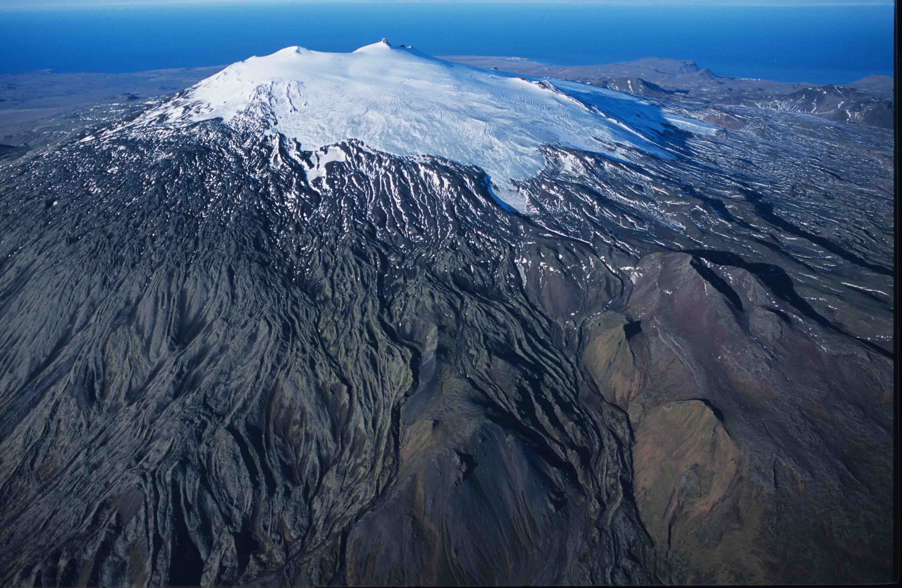
Oddur Sigurðsson Kolbrún Svala Hjaltadóttir
Iceland Land of Ice and Fire
People
Culture

Slide 2
The trinity of land, nation and language
Land þjóð og tunga, þrenning sönn og ein, þér var ég gefinn barn á móðurkné; ég lék hjá þér við læk og blóm og stein, þú leiddir mig í orðs þíns háu vé. Snorri Hjartarson | Land, people, and language, trinity holy and one, I was given to you as a child on my mother's knee; I played beside you by stream and flower and stone, you led me into the high temple of your word.

Slide 3
Evolution of a nation
A nation will not evolve without the land it lives on (including its living nature), nor independent of its language. Thus, we will try to give you a snapshot of the land, the people and the language.

Slide 4
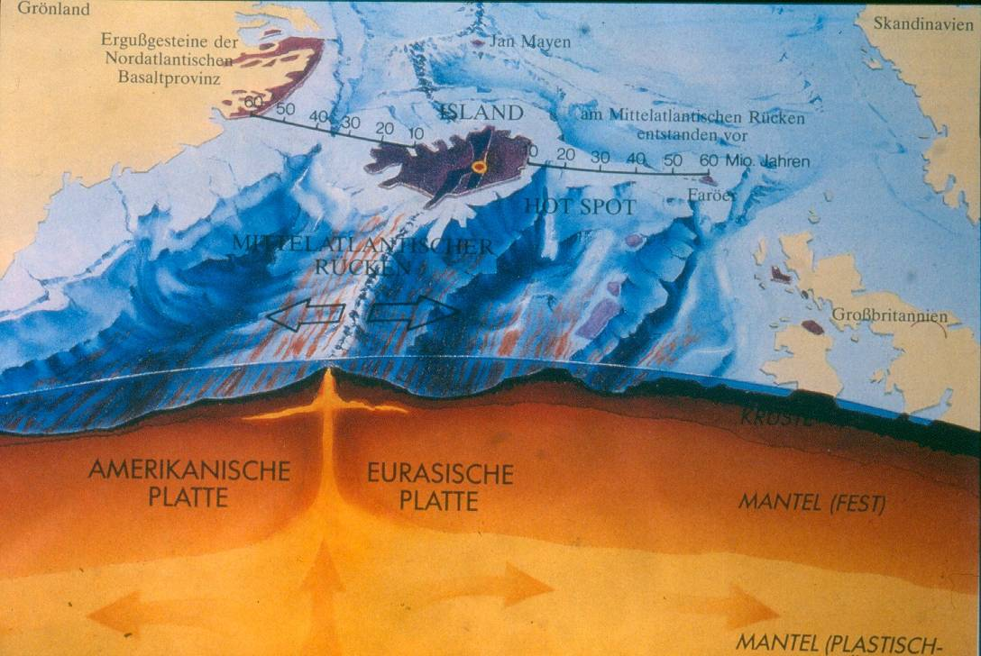
Notes:
Section through the Earths crust and upper mantle showing sea floor spreading by Iceland

Slide 5
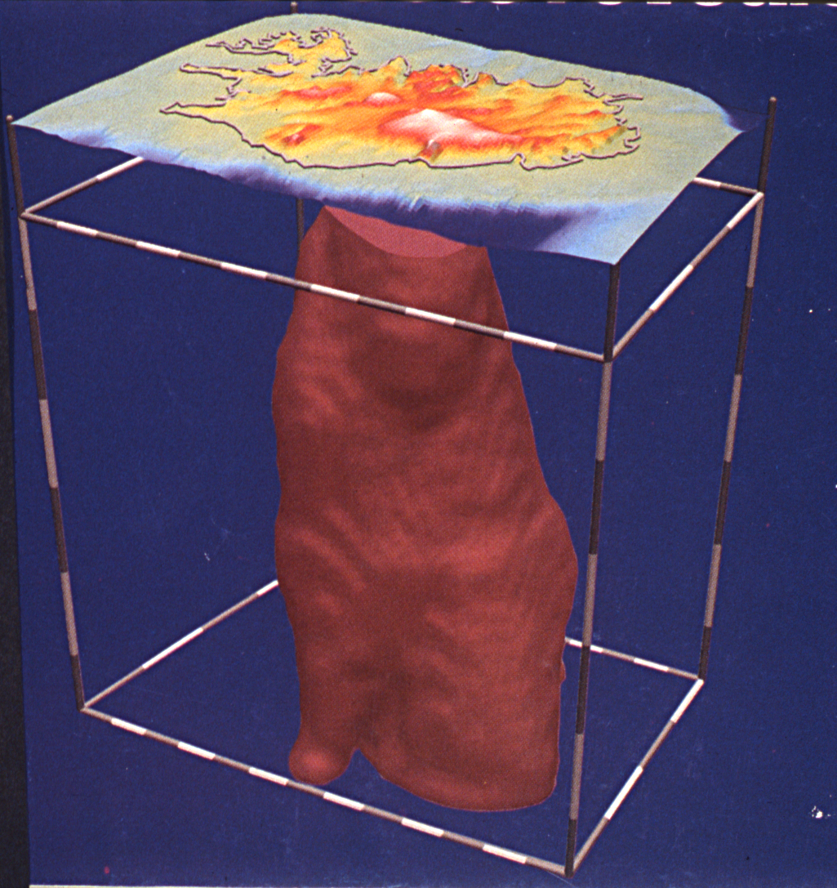
Notes:
A seismic rendering of the hypothetical mantle plume below Iceland

Slide 6
Iceland
Notes:
Iceland fits into A4 format, with catchy outline, 1/10 covered by glaciers, 30 volcanic systems,

Slide 7
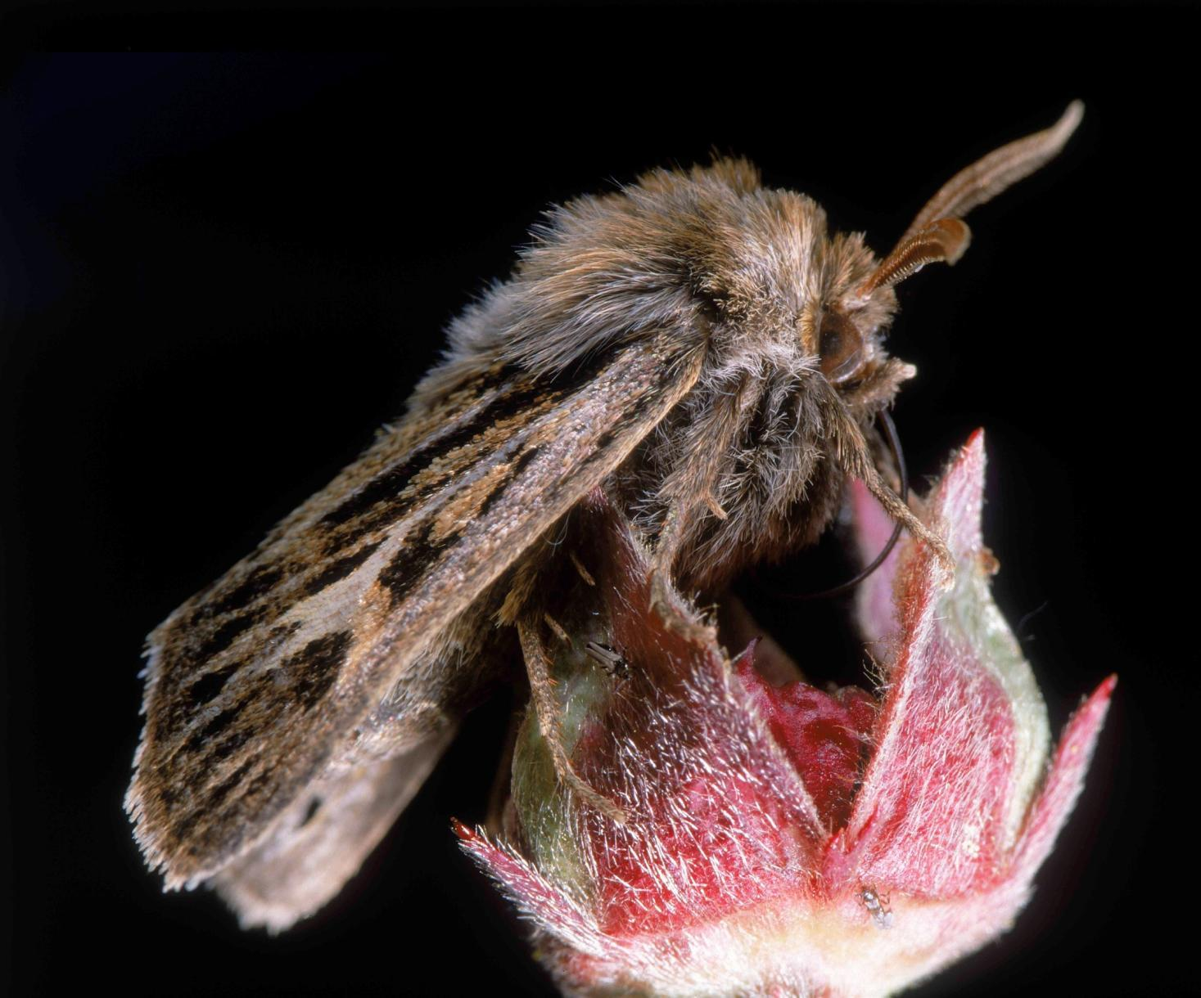

Slide 8
Volcanism in Iceland
30 active volcanic systems
>30 volcanic eruptions per century
10-15 subglacial eruptions per century
Magma output rates: >5 km³ per century

Slide 9
Bárðarbunga volcano

Slide 10
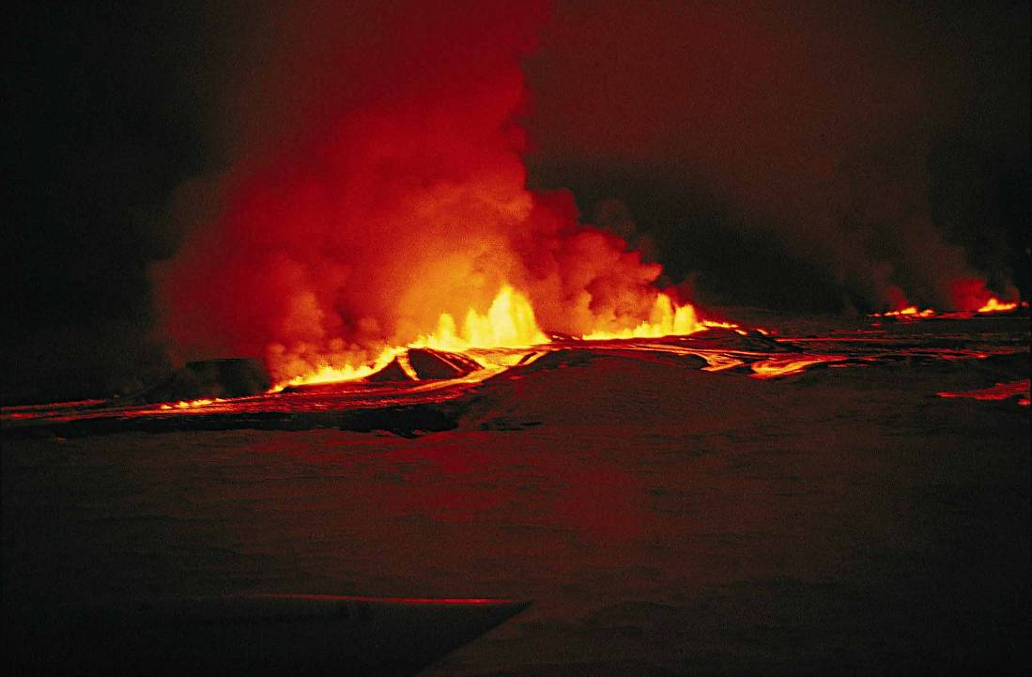
Notes:
A typical fissure eruption starts with a continuous curtain of lava squirting out of a fissure. Gjástykki, northern Iceland October 1980. Sprungugos í Gjástykki í október 1980.

Slide 11
Photo: Óttar Finnsson
Notes:
The ongoing eruption at Fagraskógarfjall, SW Iceland

Slide 12
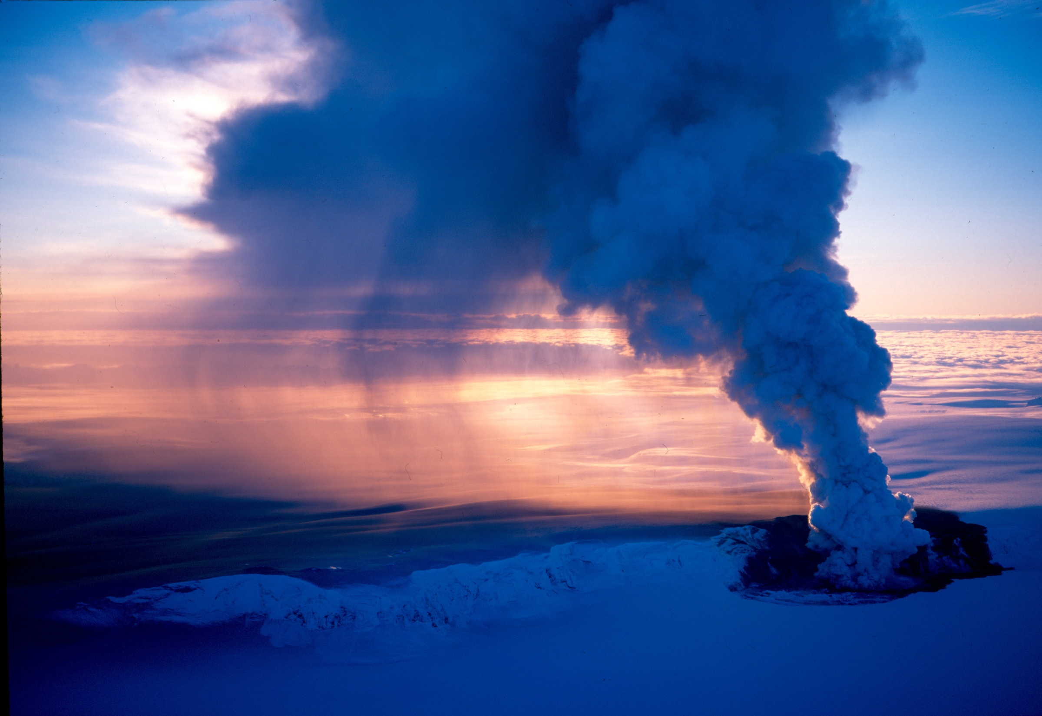
Grímsvötn volcanic eruption 19. desember 1998

Slide 13
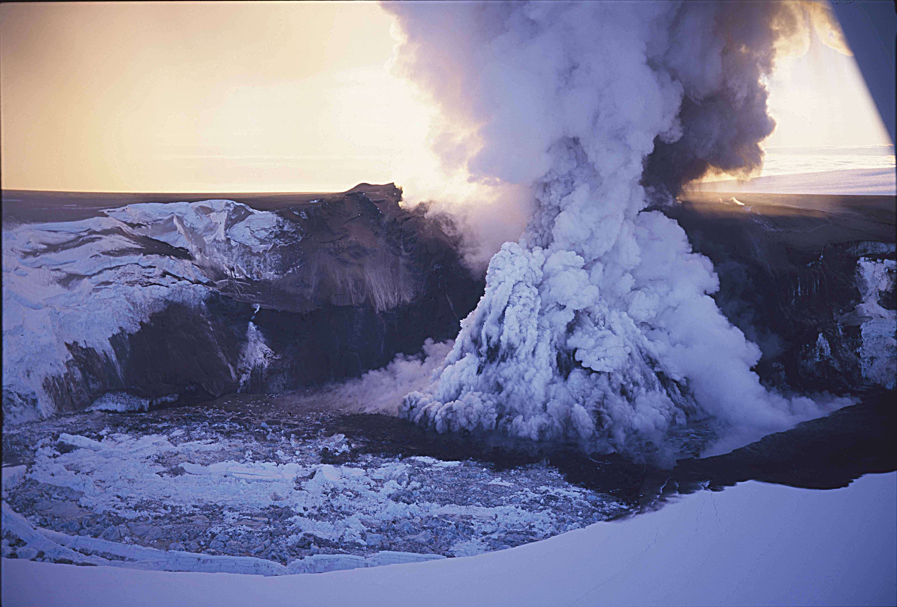
Grímsvötn volcanic eruption 19. desember 1998

Slide 14
Eyjafjallajökull eruption 2010

Slide 16
Sólheimajökull outlet glacier

Slide 17
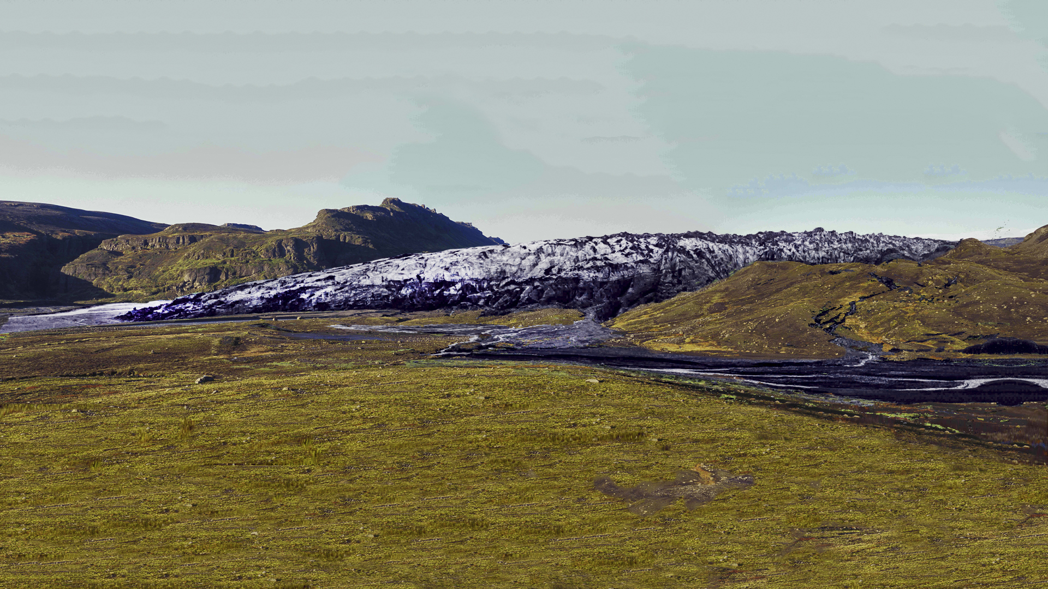
1997

Slide 18
2000

Slide 19
2003

Slide 20
2006

Slide 21
2008

Slide 22
2010

Slide 23
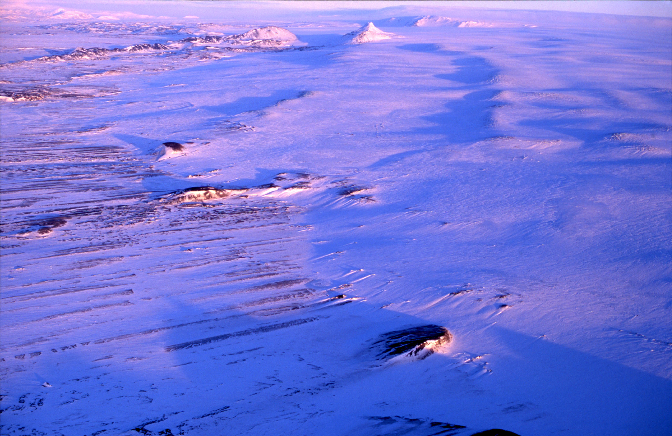
Surge-type Tungnárjökull 7. janúar 1994

Slide 24
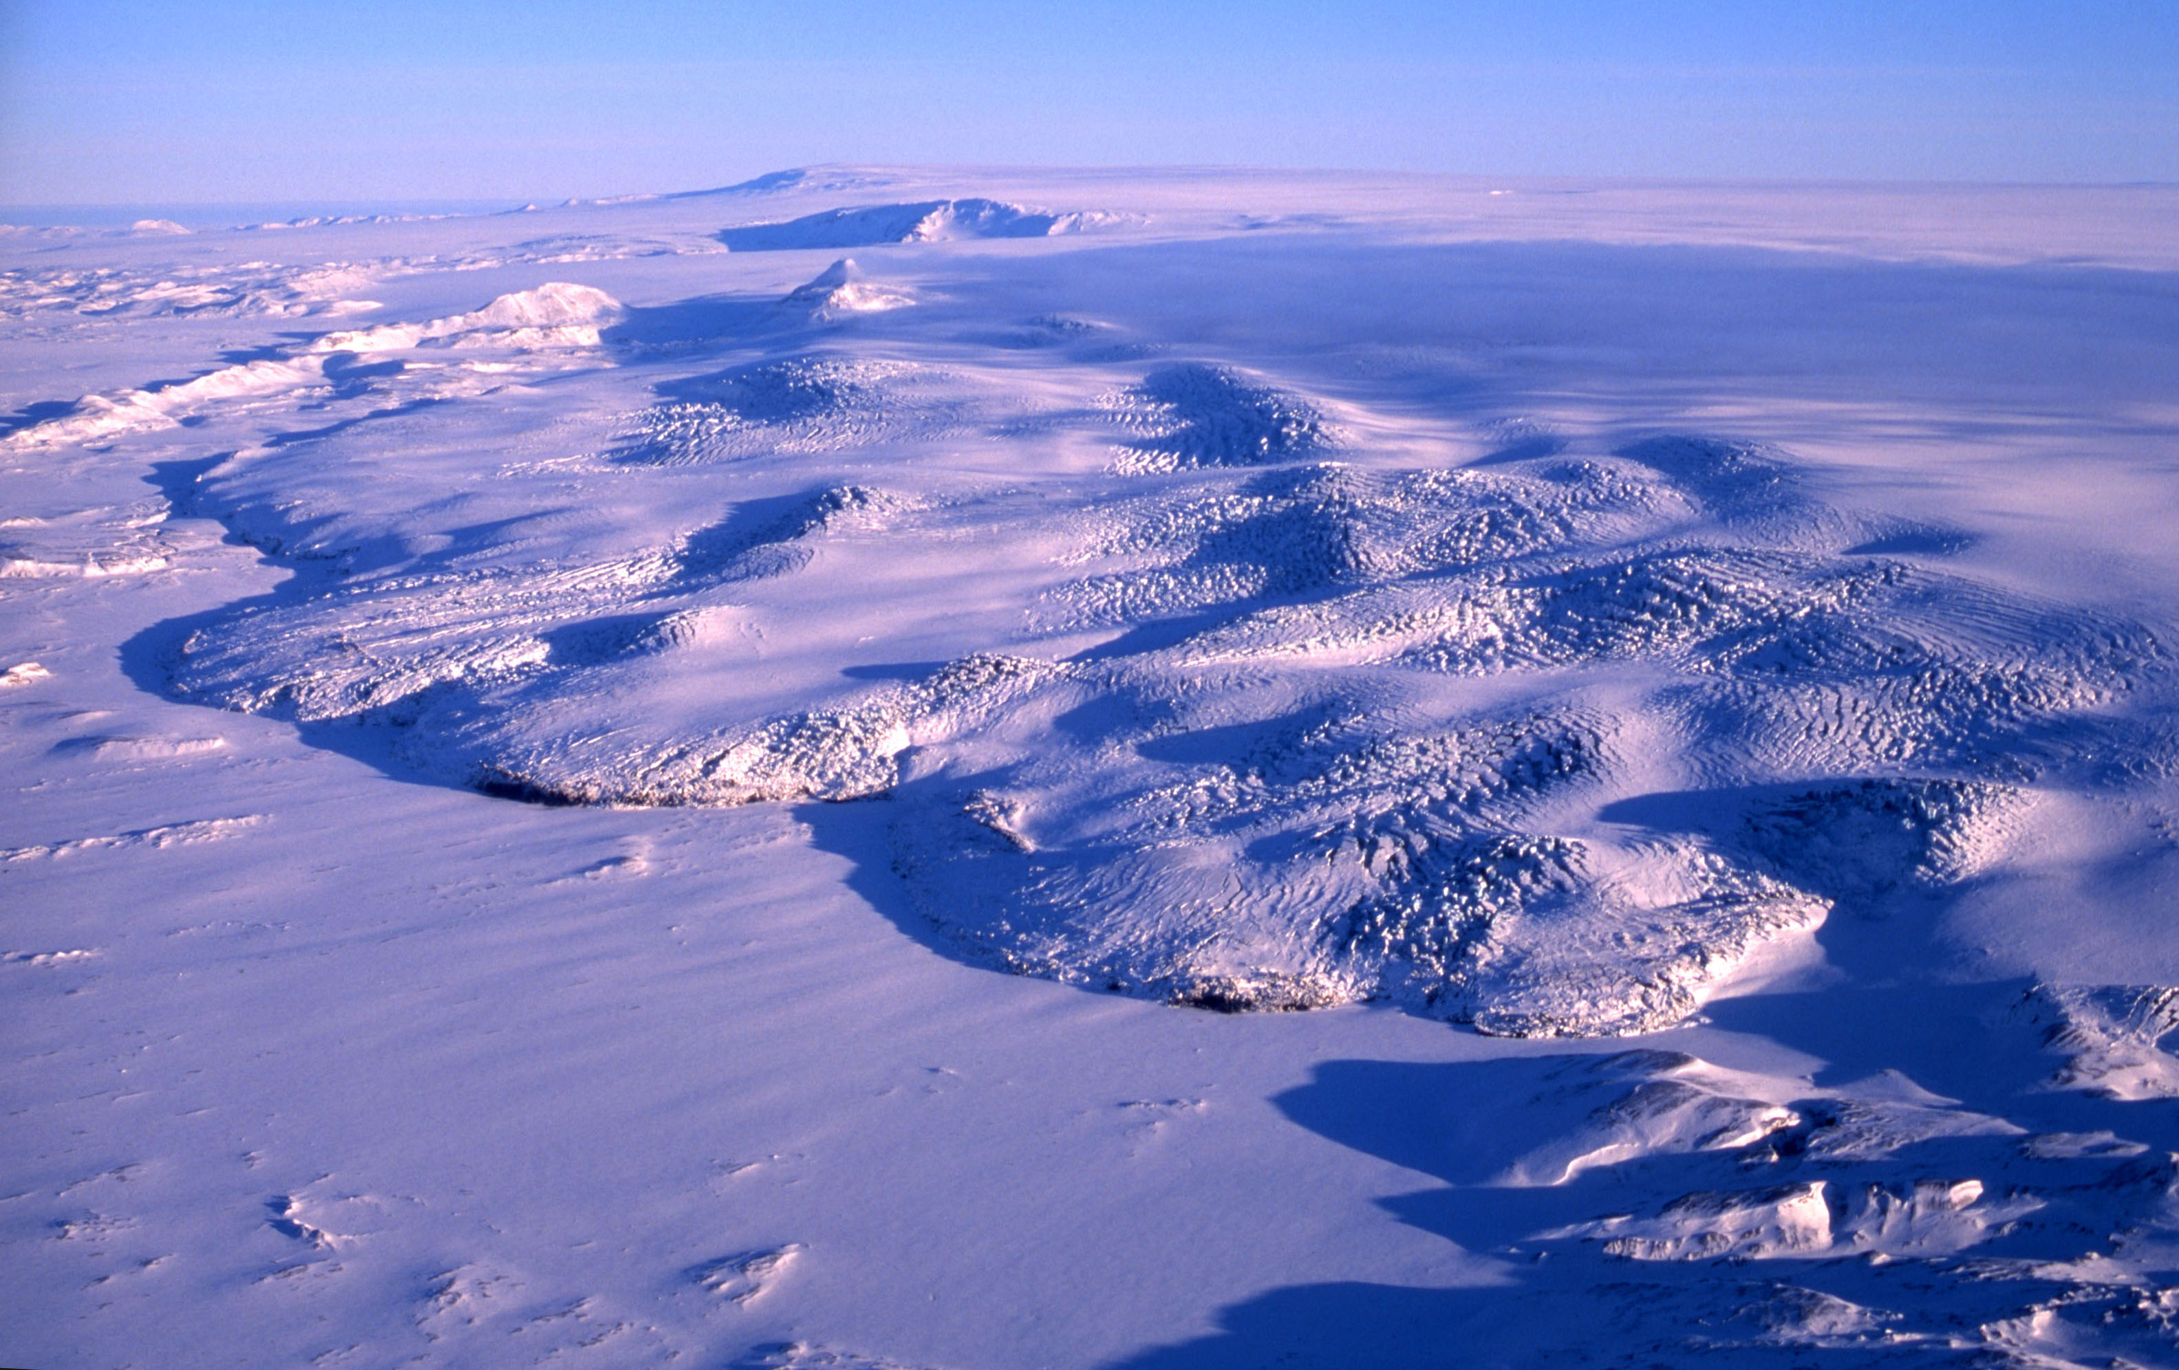
Surge-type Tungnárjökull 8. febrúar 1995

Slide 25
Síðujökull during surge 1994

Slide 26
An ice cave

Slide 28
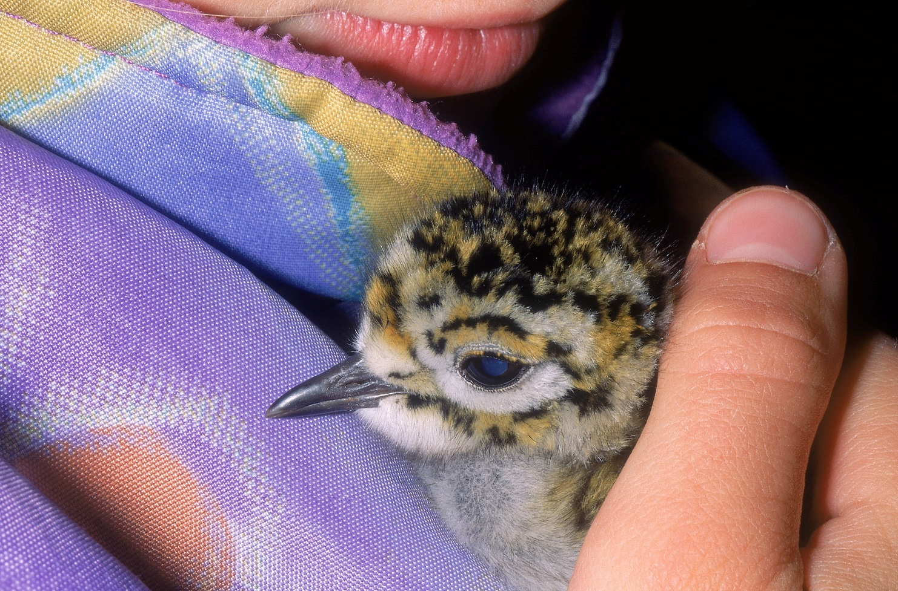

Slide 29
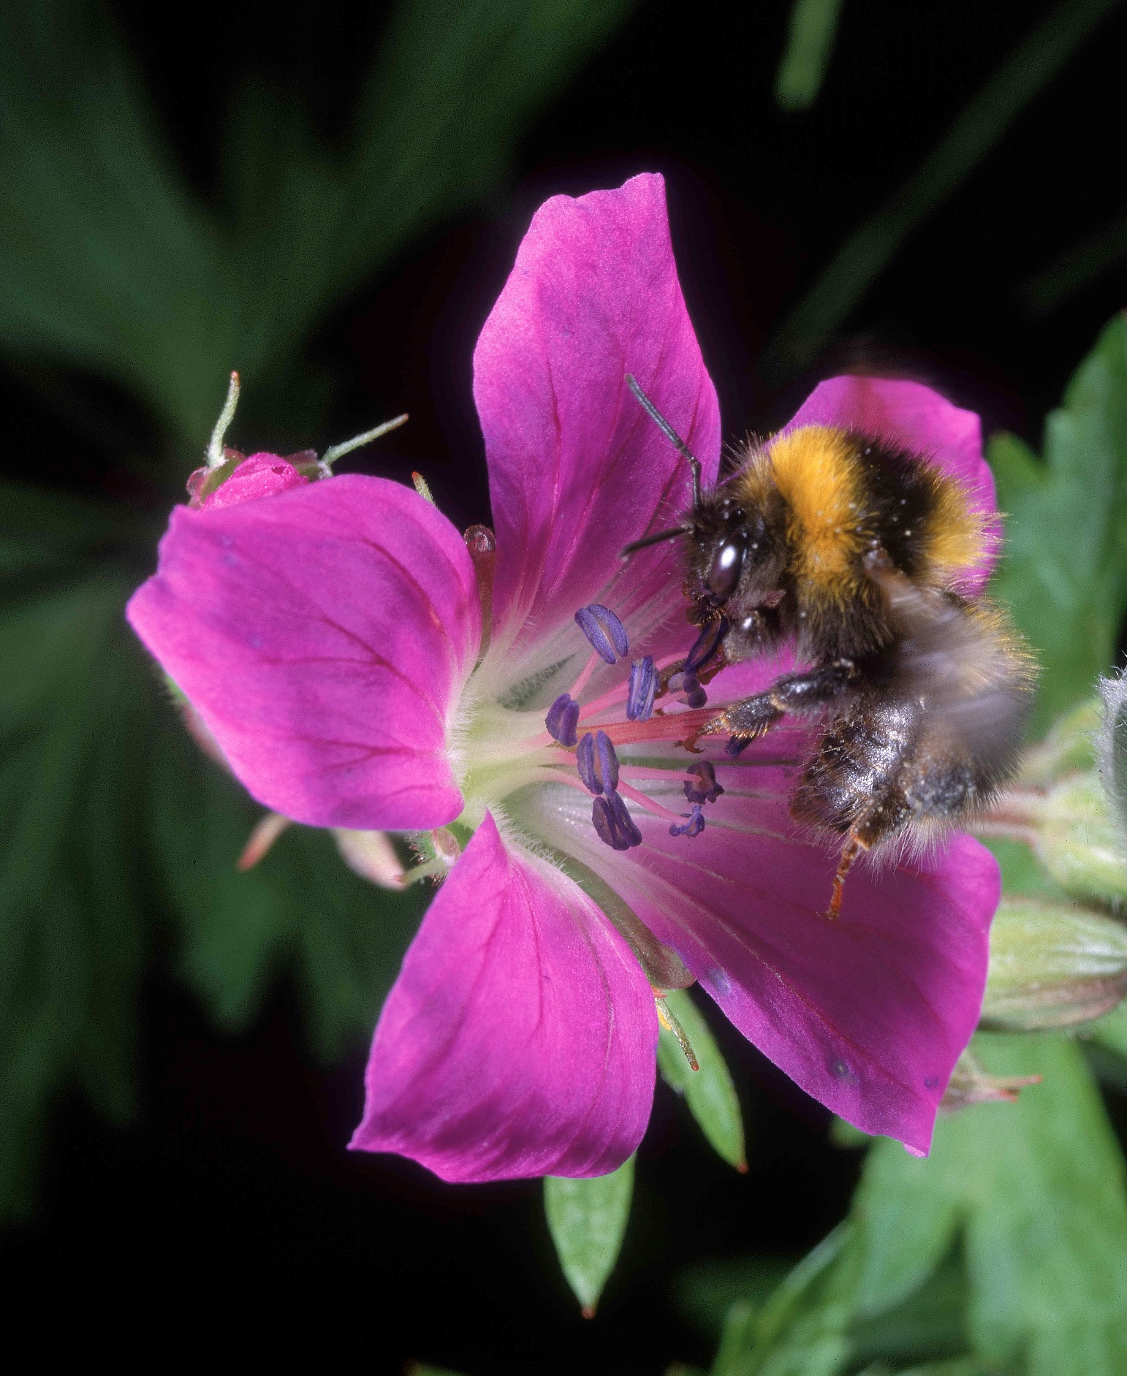

Slide 30
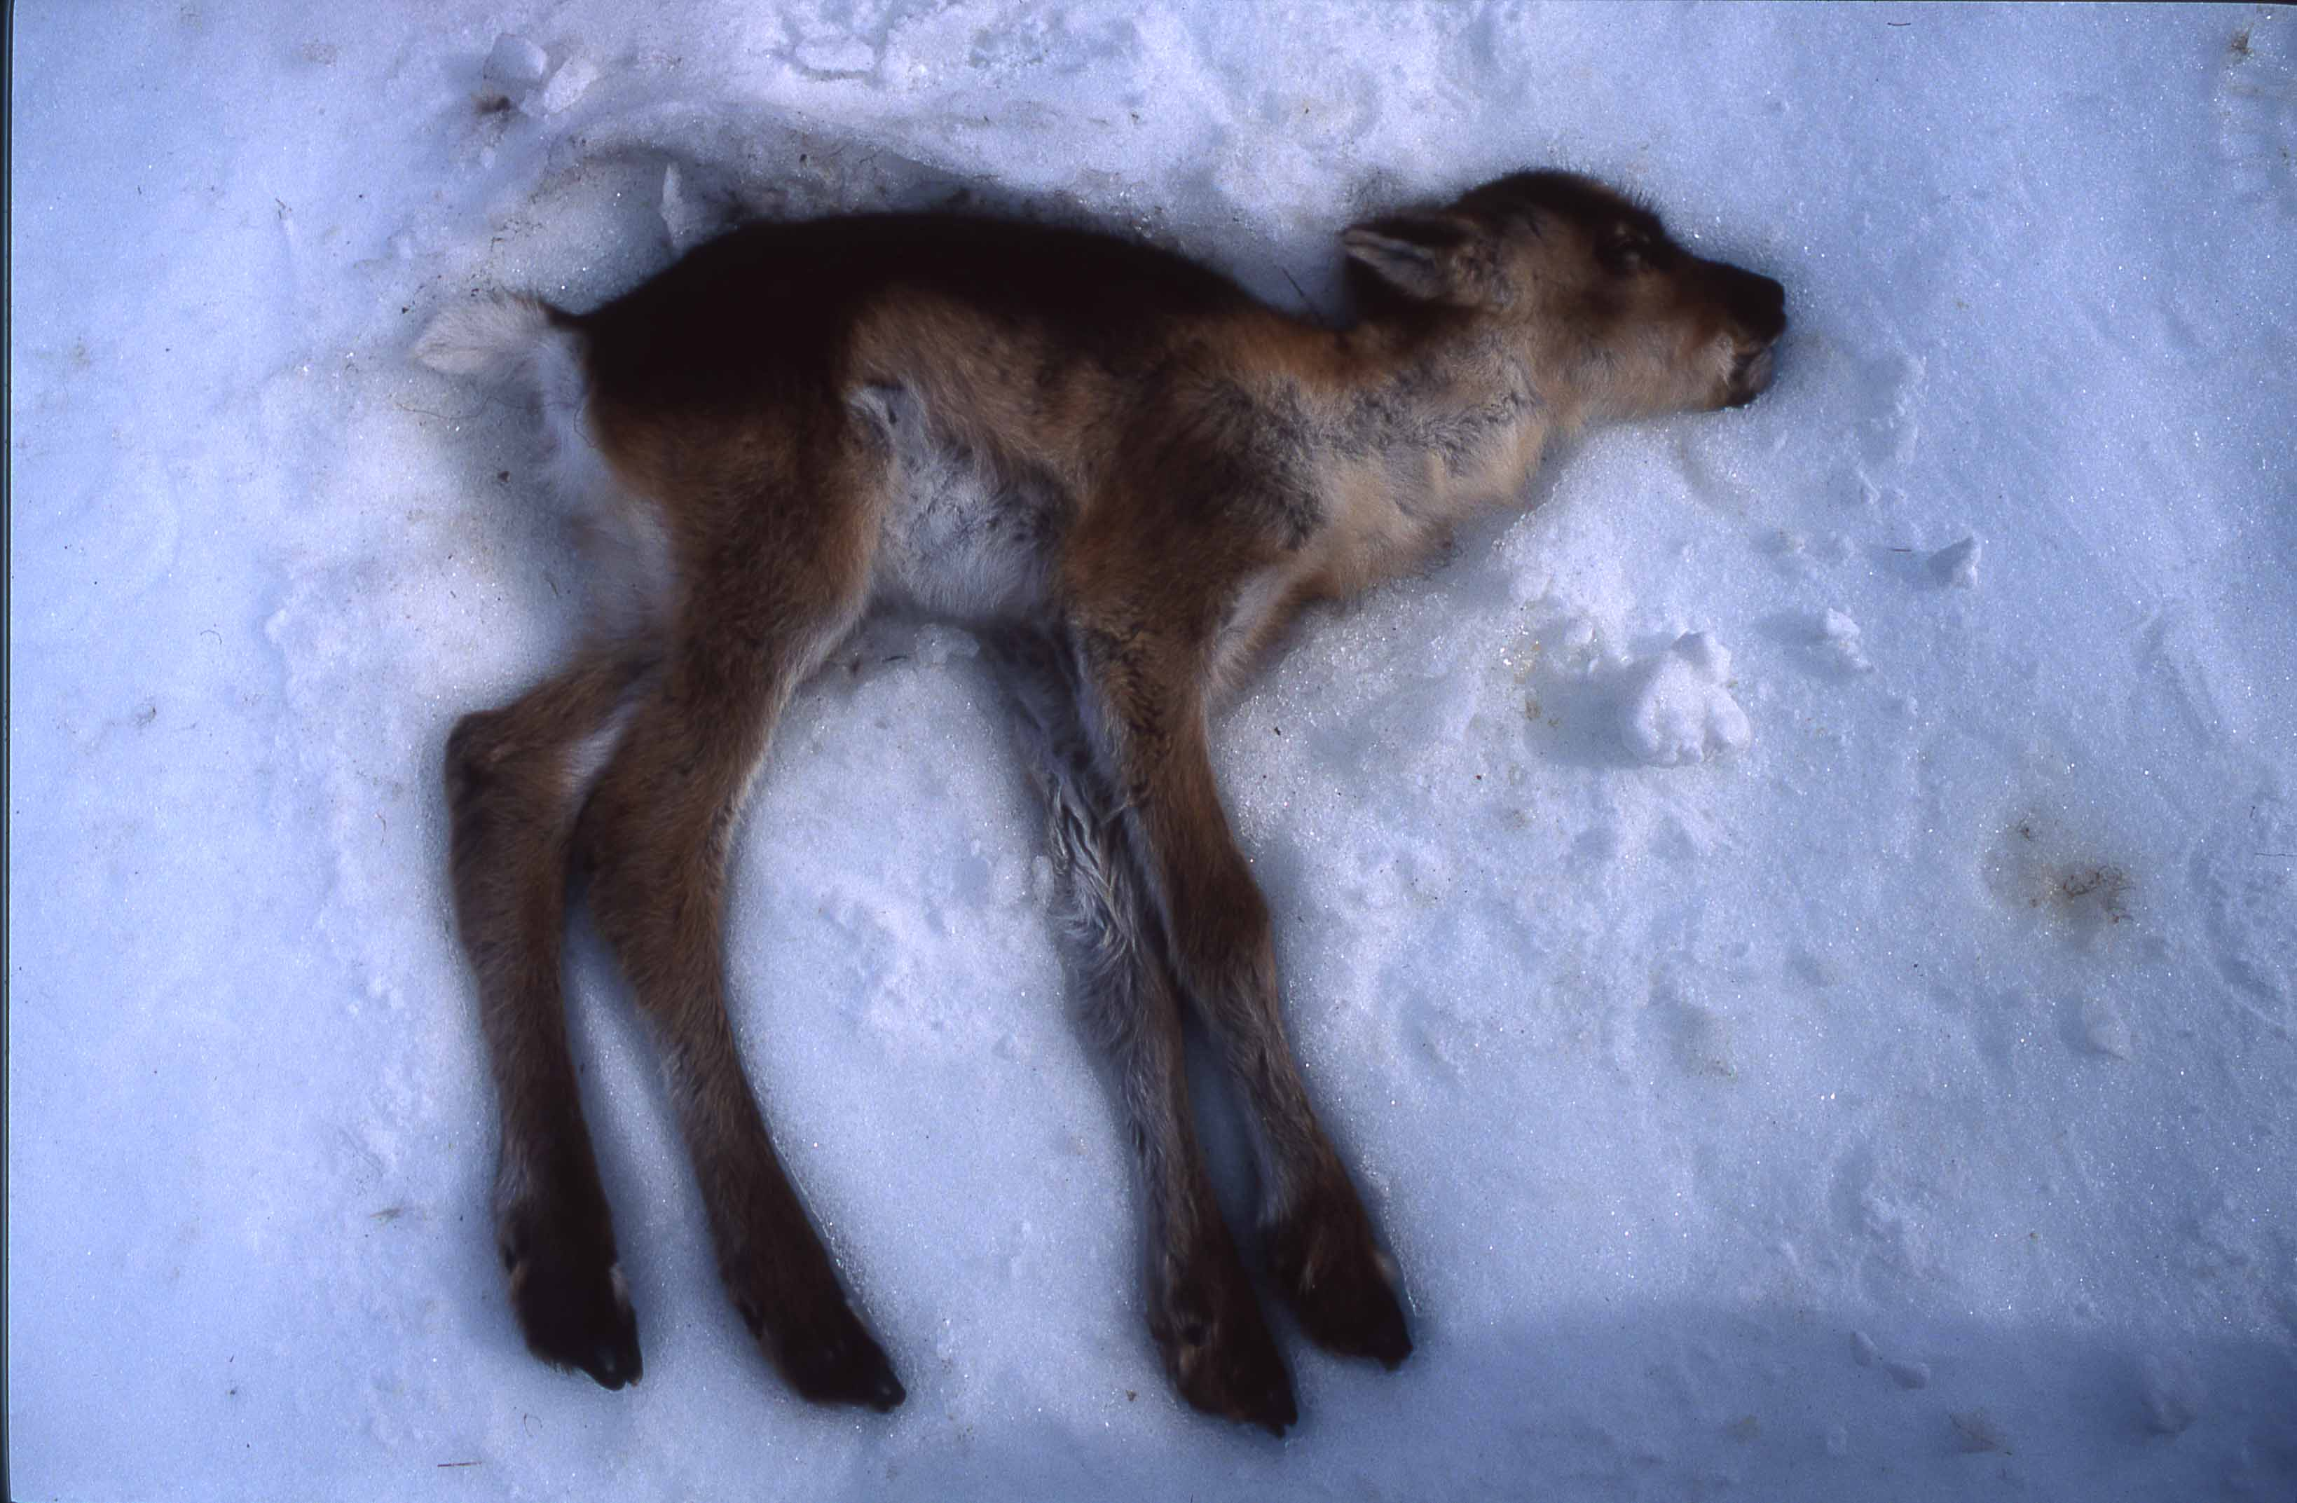

Slide 32
History
~870-930 Settlement
930 Parliament (Commonwealth) established at Þingvellir. It is still the legislative body
985 Eiríkur rauði (Erik the red) established a settlement in Greenland
1000 Christianity established as state religion
1000 Leifur Eiríksson explores Vínland (east coast of North-America)
1117 First lawbook written
1262 King of Norway rules Iceland. End of Icelandic commonwealth
1402 Black death invades Iceland killing one third of the nation
1550 Lutheranism introduce forcefully. Last Catholic bishop executed along with two of his sons
1703 The first nation wide census in the world
1783 Eruption of Laki; The Haze affected climate world wide
1874 First constitution for Iceland given by the Danish King
1904 The first local government, one minister
1918 Autonomy established under the Danish King
1944 Iceland Republic independent of Denmark,

Slide 33
Icelanders, a writing people
Enormous interest in history, local and foreign
Records of the settlement of Iceland ~874-930 CE written in early 1100s
Essay on the origin of the written language by the initiator of the alphabet
Law for the commonwealth established in 930 CE and on by the parliament
Memorized by the lawman until written down in 1117 CE and onward
History of the Norwegian and Danish kings
Preservation of the traditional poetry of Northern-Europe
Prose Edda the main source of the Norse Mythology
Annals from the beginning of the human race to contemporaneous
Icelandic sagas: novels of heroes and statesmen during the first centuries
Contemporaneous history of the 12th and 13th century
Religeous literature, history of bishops
Less than a thousand manuscripts on vellum still exist
Most vellum manuscripts (10,000 or more) are lost
>100 calves had to be slaughtered for one book. Extremely expensive

Slide 35
Icelanders, a singing people
Through the history most of music has been non-instrumental
The perfect fifth interval is a big favorite in the Icelandic folksongs
Björk is a world wide celebrity in music
Hildur Guðnadóttir won the Oscar Academy Award and many other awards

Slide 36
Lullabyes
Most of Icelandic lullabyes go in minor key
Many of them are quite frightening:
Við skulum ekki hafa hátt We shall not be laud my dear.
hér er margt að ugga. Here are many things to fear.
Eg hef heyrt í alla nátt I have heard the whole night through
andardrátt á glugga. Someone breathing at the window.
Það er margt sem myrkrið veit. Many things the darkness knows.
Minn er hugur þungur. My mind is burdened.
Oft ég svartan sandinn leit Frequently I saw the black sand
svíða grænan engireit. scorch the green meadow.
Í jöklinum hljóða dauðadjúpar sprungur. In the glacier the deadly deep crevasses are moaning.

Slide 37
Icelanders fond of team sports
Although Icelanders are only 360,000 (same size as Bochum, Germany or Cardiff, UK) they have an amazing record in team sports
Bermuda Bowl (unofficial world champion) in Bridge in 1991
Silver medal in handball in the 2008 Olympics, Beijing
Beat England in football in the European Championships in 2016
Ranked by FIFA about 20th best football nation in 2016

Slide 38
Icelanders, a fishing nation
Not far from 1% of world catch

Slide 39
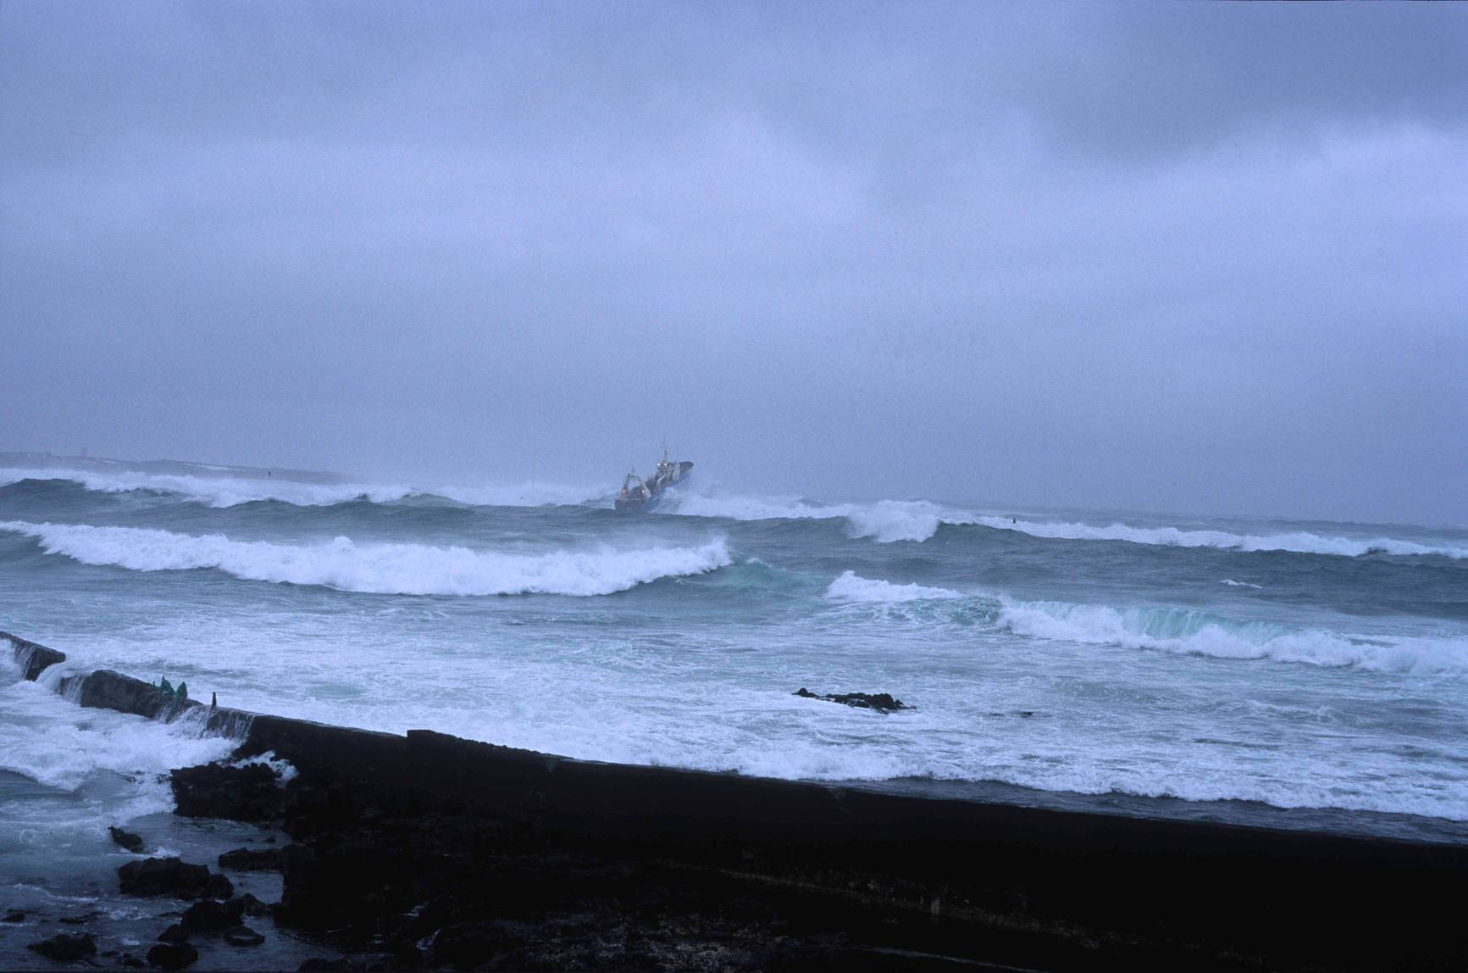

Slide 42
Notes:
Hrím á Rauðavatni

Slide 44
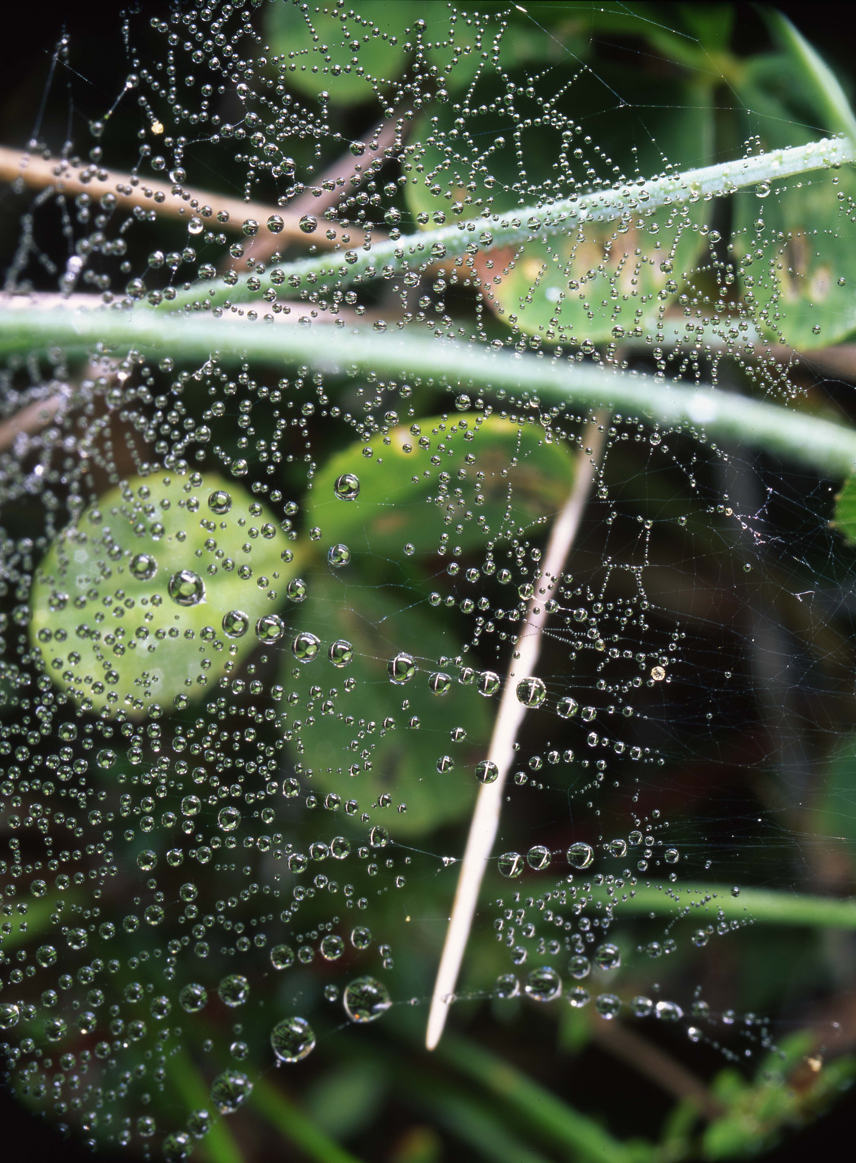

Slide 45
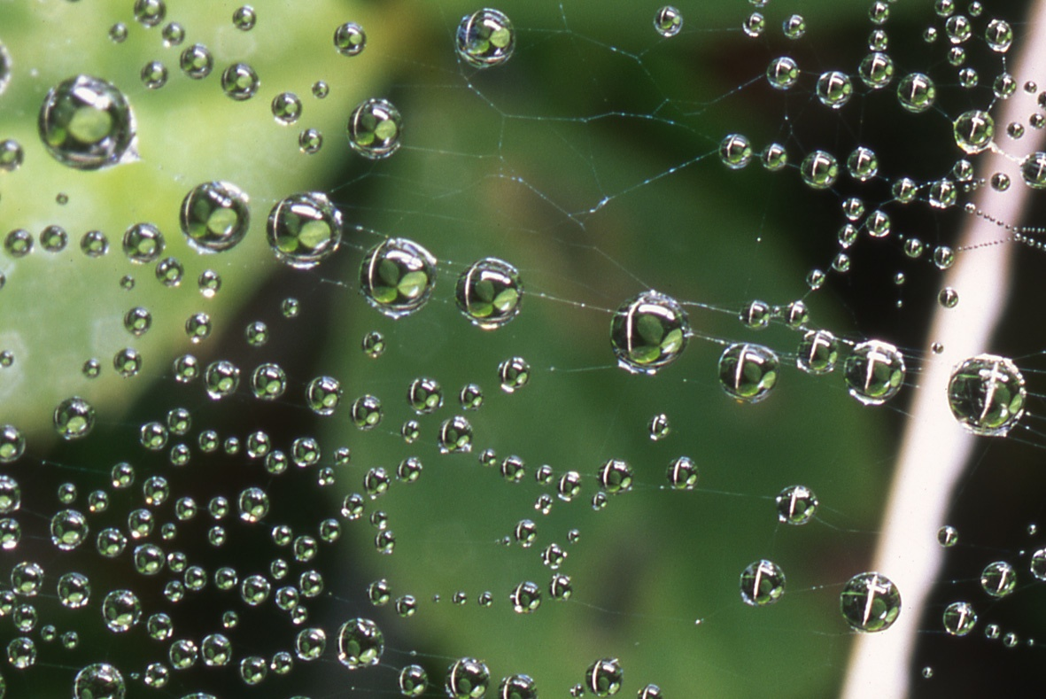

Slide 46
Teaching Icelandic
Góðan dag
Kennari
Flugvél
Sóttkví
Bólusetning
Rúta
Leigubíll
Klósett
Morgunmatur
Hlaðborð
Reykjavík
Veitingahús
Vatn
Jökull
Eyjafjallajökull
Geldingadalir
Höfn
Takk fyrir
Góða nótt

Slide 47
Teaching Icelandic
Góðan dag=good day
Kennari=teacher
Flugvél=airplane
Sóttkví=quarantine
Bólusetning=vaccination
Rúta=bus
Leigubíll = taxi
Klósett=restroom
Morgunmatur=breakfast
Hlaðborð=buffet
Reykjavík=capital
Veitingahús=restaurant
Vatn=water
Jökull=glaccier
Eyjafjallajökull
Geldingadalir
Höfn
Takk fyrir=thank you
Takk fyrir maturinn var góður=thank you the meal was good
Góða nótt=good night

